Slide 1
Chapter 6: Deadlocks

Slide 2
Overview
Resources
Why do deadlocks occur?
Dealing with deadlocks
Ignoring them: ostrich algorithm
Detecting & recovering from deadlock
Avoiding deadlock
Preventing deadlock

Slide 3
Resources
Resource: something a process uses
Usually limited (at least somewhat)
Examples of computer resources
Printers
Semaphores / locks
Tables (in a database)
Processes need access to resources in reasonable order
Two types of resources:
Preemptable resources: can be taken away from a process with no ill effects
Nonpreemptable resources: will cause the process to fail if taken away

Slide 4
When do deadlocks happen?
Suppose
Process 1 holds resource A and requests resource B
Process 2 holds B and requests A
Both can be blocked, with neither able to proceed
Deadlocks occur when …
Processes are granted exclusive access to devices or software constructs (resources)
Each deadlocked process needs a resource held by another deadlocked process
Process 1
Process 2
A
B
A
B
DEADLOCK!

Slide 5
Using resources
Sequence of events required to use a resource
Request the resource
Use the resource
Release the resource
Can’t use the resource if request is denied
Requesting process has options
Block and wait for resource
Continue (if possible) without it: may be able to use an alternate resource
Process fails with error code
Some of these may be able to prevent deadlock…

Slide 6
What is a deadlock?
Formal definition: “A set of processes is deadlocked if each process in the set is waiting for an event that only another process in the set can cause.”
Usually, the event is release of a currently held resource
In deadlock, none of the processes can
Run
Release resources
Be awakened

Slide 7
Four conditions for deadlock
Mutual exclusion
Each resource is assigned to at most one process
Hold and wait
A process holding resources can request more resources
No preemption
Previously granted resources cannot be forcibly taken away
Circular wait
There must be a circular chain of 2 or more processes where each is waiting for a resource held by the next member of the chain

Slide 8
Resource allocation graphs
Resource allocation modeled by directed graphs
Example 1:
Resource R assigned to process A
Example 2:
Process B is requesting / waiting for resource S
Example 3:
Process C holds T, waiting for U
Process D holds U, waiting for T
C and D are in deadlock!
A
B
R
S
T
C
D
U

Slide 9
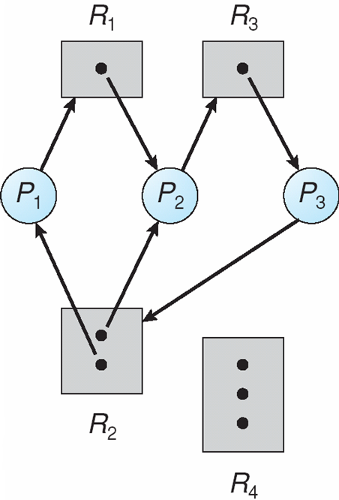
Resource Allocation Graph: Multiple Resources

Slide 10
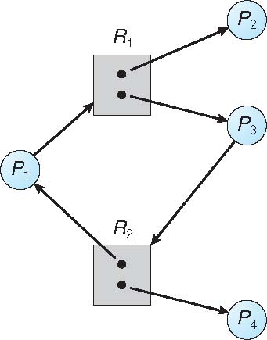
Graph With A Cycle But No Deadlock

Slide 11
Basic Facts
If graph contains no cycles ⇒ no deadlock
If graph contains a cycle ⇒
if only one instance per resource type, then deadlock
necessary and sufficient condition
if several instances per resource type, possibility of deadlock
necessary condition

Slide 12
Dealing with deadlock
How can the OS deal with deadlock?
Ignore the problem altogether!
Hopefully, it’ll never happen…
Detect deadlock & recover from it
Dynamically avoid deadlock
Careful resource allocation
Prevent deadlock
Remove at least one of the four necessary conditions
We’ll explore these tradeoffs

Slide 13
Getting into deadlock
A
B
C
Acquire R
Acquire S
Release R
Release S
Acquire S
Acquire T
Release S
Release T
Acquire T
Acquire R
Release T
Release R
A
B
C
A
B
C
A
B
C
R
S
T
R
S
T
R
S
T
Acquire R
Acquire S
Acquire T
A
B
C
A
B
C
A
B
C
R
S
T
R
S
T
R
S
T
Deadlock!
Acquire S
Acquire T
Acquire R

Slide 14
Not getting into deadlock…
Many situations may result in deadlock (but don’t have to)
In previous example, A could release R before C requests R, resulting in no deadlock
Can we always get out of it this way?
Find ways to:
Detect deadlock and reverse it
Stop it from happening in the first place

Slide 15
The Ostrich Algorithm
Pretend there’s no problem
Reasonable if
Deadlocks occur very rarely
Cost of prevention is high
UNIX and Windows take this approach
Resources (memory, CPU, disk space) are plentiful
Deadlocks over such resources rarely occur
Deadlocks typically handled by rebooting
Trade off between convenience and correctness

Slide 16


Slide 17
Detecting deadlocks using graphs
Process holdings and requests in the table and in the graph (they’re equivalent)
Graph contains a cycle => deadlock!
Easy to pick out by looking at it (in this case)
Need to mechanically detect deadlock
Not all processes are deadlocked (A, C, F not in deadlock)
R
A
B
Process | Holds | Wants
A | R | S
B |  | T
C |  | S
D | U | S,T
E | T | V
F | W | S
G | V | U
C
S
D
T
E
F
U
V
W
G

Slide 18
Deadlock detection algorithm
General idea: try to find cycles in the resource allocation graph
Algorithm: depth-first search at each node
Mark arcs as they’re traversed
Build list of visited nodes
If node to be added is already on the list, a cycle exists!
Cycle == deadlock
For each node N in the graph {
Set L = empty list
unmark all arcs
Traverse (N,L)
}
If no deadlock reported by now, there isn’t any
define Traverse (C,L) {
If C in L, report deadlock!
Add C to L
For each unmarked arc from C {
Mark the arc
Set A = arc destination
/* NOTE: L is a
local variable */
Traverse (A,L)
}
}

Slide 19
Resources with multiple instances
Previous algorithm only works if there’s one instance of each resource
If there are multiple instances of each resource, we need a different method
Track current usage and requests for each process
To detect deadlock, try to find a scenario where all processes can finish
If no such scenario exists, we have deadlock

Slide 20
Deadlock detection algorithm
 | A | B | C | D
Avail | 2 | 3 | 0 | 1
current=avail;
for (j = 0; j < N; j++) {
for (k=0; k<N; k++) {
if (finished[k])
continue;
if (want[k] < current) {
finished[k] = 1;
current += hold[k];
break;
}
if (k==N) {
printf “Deadlock!\n”;
// finished[k]==0 means process is in
// the deadlock
break;
}
}
Process | A | B | C | D
1 | 0 | 3 | 0 | 0
2 | 1 | 0 | 1 | 1
3 | 0 | 2 | 1 | 0
4 | 2 | 2 | 3 | 0
Hold
Process | A | B | C | D
1 | 3 | 2 | 1 | 0
2 | 2 | 2 | 0 | 0
3 | 3 | 5 | 3 | 1
4 | 0 | 4 | 1 | 1
Want
Note: want[j],hold[j],current,avail are arrays!

Slide 21
Detection-Algorithm Usage
When, and how often, to invoke depends on:
How often a deadlock is likely to occur?
How many processes will need to be rolled back?
one for each disjoint cycle
If detection algorithm is invoked arbitrarily, there may be many cycles in the resource graph and so we would not be able to tell which of the many deadlocked processes “caused” the deadlock.

Slide 22
Recovering from deadlock: options
Recovery through resource preemption
Take a resource from some other process
Depends on nature of the resource and the process
Recovery through rollback
Checkpoint a process periodically
Use this saved state to restart the process if it is found deadlocked
May present a problem if the process affects lots of “external” things
Recovery through killing processes
Crudest but simplest way to break a deadlock: kill one of the processes in the deadlock cycle
Other processes can get its resources
Preferably, choose a process that can be rerun from the beginning
Pick one that hasn’t run too far already

Slide 23
Deadlock Recovery: Process Termination
Abort all deadlocked processes
Abort one process at a time until the deadlock cycle is eliminated
In which order should we choose to abort?
Priority of the process
How long process has computed, and how much longer to completion
Resources the process has used
Resources process needs to complete
How many processes will need to be terminated
Is process interactive or batch?

Slide 24
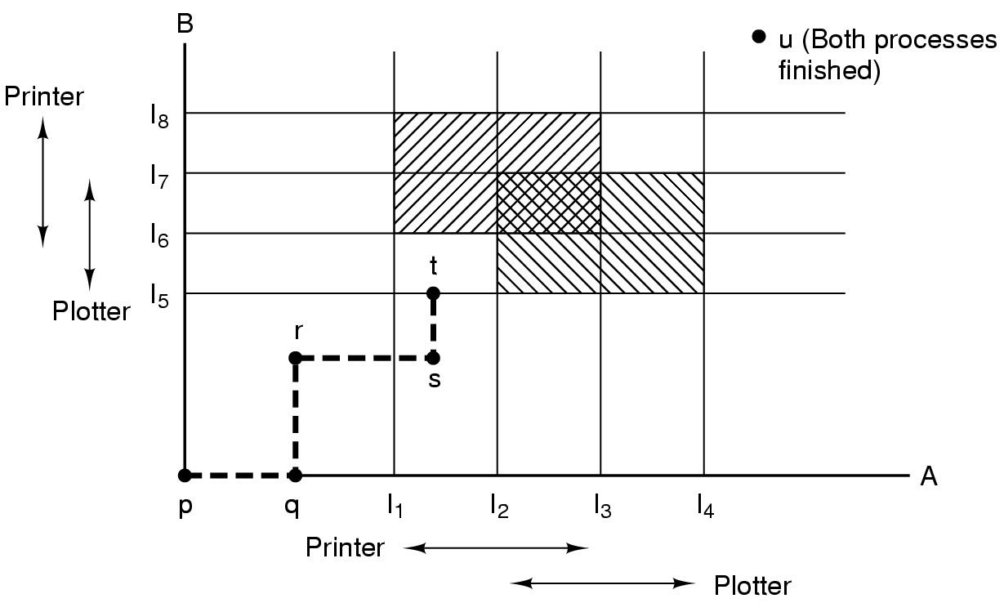
Resource trajectories
Two process resource trajectories

Slide 25
Safe and unsafe states
 | Has | Max
A | 3 | 9
B | 2 | 4
C | 2 | 7
Free: 3
 | Has | Max
A | 3 | 9
B | 4 | 4
C | 2 | 7
Free: 1
 | Has | Max
A | 3 | 9
B | 0 | -
C | 2 | 7
Free: 5
 | Has | Max
A | 3 | 9
B | 0 | -
C | 7 | 7
Free: 0
 | Has | Max
A | 3 | 9
B | 0 | -
C | 0 | -
Free: 7
Demonstration that the first state is safe
 | Has | Max
A | 3 | 9
B | 2 | 4
C | 2 | 7
Free: 3
 | Has | Max
A | 4 | 9
B | 2 | 4
C | 2 | 7
Free: 2
 | Has | Max
A | 4 | 9
B | 4 | 4
C | 2 | 7
Free: 0
 | Has | Max
A | 4 | 9
B | 0 | -
C | 2 | 7
Free: 4
Demonstration that the second state is unsafe

Slide 26
Banker's Algorithm for a single resource
 | Has | Max
A | 0 | 6
B | 0 | 5
C | 0 | 4
D | 0 | 7
Free: 10
 | Has | Max
A | 1 | 6
B | 1 | 5
C | 2 | 4
D | 4 | 7
Free: 2
 | Has | Max
A | 1 | 6
B | 2 | 5
C | 2 | 4
D | 4 | 7
Free: 1
Any sequence finishes
C,B,A,D finishes
Deadlock (unsafe state)
Bankers’ algorithm: before granting a request, ensure that a sequence exists that will allow all processes to complete
Use previous methods to find such a sequence
If a sequence exists, allow the requests
If there’s no such sequence, deny the request
Can be slow: must be done on each request!

Slide 27
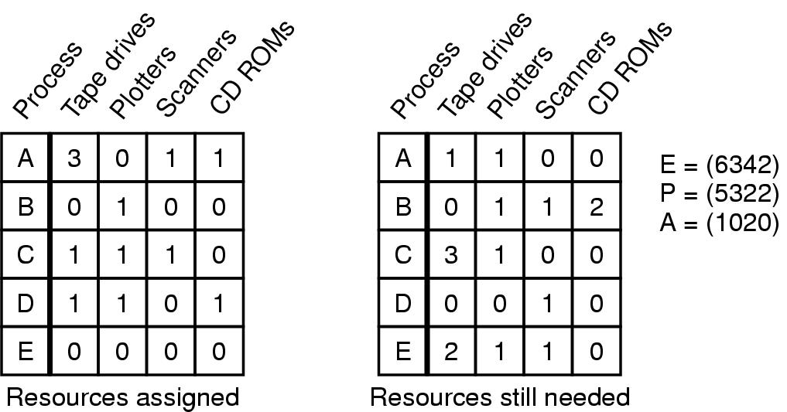
Banker's Algorithm for multiple resources
Example of banker's algorithm with multiple resources

Slide 28
Preventing deadlock
Deadlock can be completely prevented!
Ensure that at least one of the conditions for deadlock never occurs
Mutual exclusion
Circular wait
Hold & wait
No preemption
Not always possible…

Slide 29
Eliminating mutual exclusion
Some devices (such as printer) can be spooled
Only the printer daemon uses printer resource
This eliminates deadlock for printer
Not all devices can be spooled
Principle:
Avoid assigning resource when not absolutely necessary
As few processes as possible actually claim the resource

Slide 30
Attacking “hold and wait”
Require processes to request resources before starting
A process never has to wait for what it needs
This can present problems
A process may not know required resources at start of run
This also ties up resources other processes could be using
Processes will tend to be conservative and request resources they might need
Variation: a process must give up all resources before making a new request
Process is then granted all prior resources as well as the new ones
Problem: what if someone grabs the resources in the meantime—how can the process save its state?

Slide 31
Attacking “no preemption”
This is not usually a viable option
Consider a process given the printer
Halfway through its job, take away the printer
Confusion ensues!
May work for some resources
Forcibly take away memory pages, suspending the process
Process may be able to resume with no ill effects

Slide 32
Attacking “circular wait”
Assign an order to resources
Always acquire resources in numerical order
Need not acquire them all at once!
Circular wait is prevented
A process holding resource n can’t wait for resource m if m < n
No way to complete a cycle
Place processes above the highest resource they hold and below any they’re requesting
All arrows point up!
D
C
3
2
B
1
A

Slide 33
Deadlock prevention: summary
Mutual exclusion
Spool everything
Hold and wait
Request all resources initially
No preemption
Take resources away
Circular wait
Order resources numerically

Slide 34
Example: two-phase locking
Phase One
Process tries to lock all data it needs, one at a time
If needed data found locked, start over
(no real work done in phase one)
Phase Two
Perform updates
Release locks
Note similarity to requesting all resources at once
This is often used in databases
It avoids deadlock by eliminating the “hold-and-wait” deadlock condition

Slide 35
“Non-resource” deadlocks
Possible for two processes to deadlock
Each is waiting for the other to do some task
Can happen with semaphores
Each process required to do a down() on two semaphores (mutex and another)
If done in wrong order, deadlock results
Semaphores could be thought of as resources…

Slide 36
Starvation
Algorithm to allocate a resource (akin to scheduling)
Give the resource to the shortest job first
Works great for multiple short jobs in a system
May cause long jobs to be postponed indefinitely
Solution
First-come, first-serve policy
Starvation can lead to deadlock
Process starved for resources can be holding (other) resources
If those resources aren’t used and released in a timely fashion, shortage could lead to deadlock
Is this in general or for deadlocks?

